Slide 1
REINFORCEMENT LEARNING

Slide 2
WHAT IS REINFORCEMENT LEARNING

Slide 3
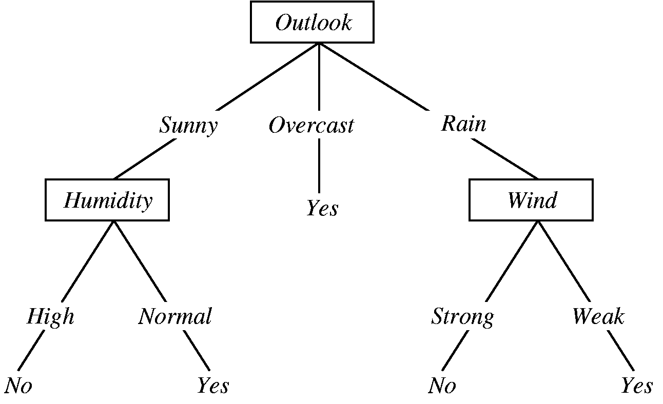
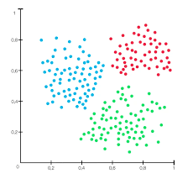

There are three types of machine learning:
Supervised Learning: The machine is trained on a labeled dataset, and on the basis of that data, it will generate the output. The training data provided to the machines work as the supervisor that teaches the machines to predict the output correctly. In real-world applications are risk assessment, image classification, fraud detection, and spam filtering etc.
Unsupervised Learning: The machine is trained on unlabeled dataset, and the system tries to learn the patterns, structures, or relationships within the data without explicit guidance. In real-world applications are anomaly detection in cybersecurity, social network analysis and recommendation systems etc.
Reinforcement Learning: It is a type of machine learning where an agent learns how to behave in an environment by performing actions and receiving feedback in terms of rewards or penalties. In real-world applications are artificial intelligence, robotics and autonomous vehicles etc.

Slide 4
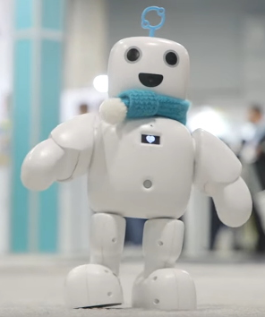
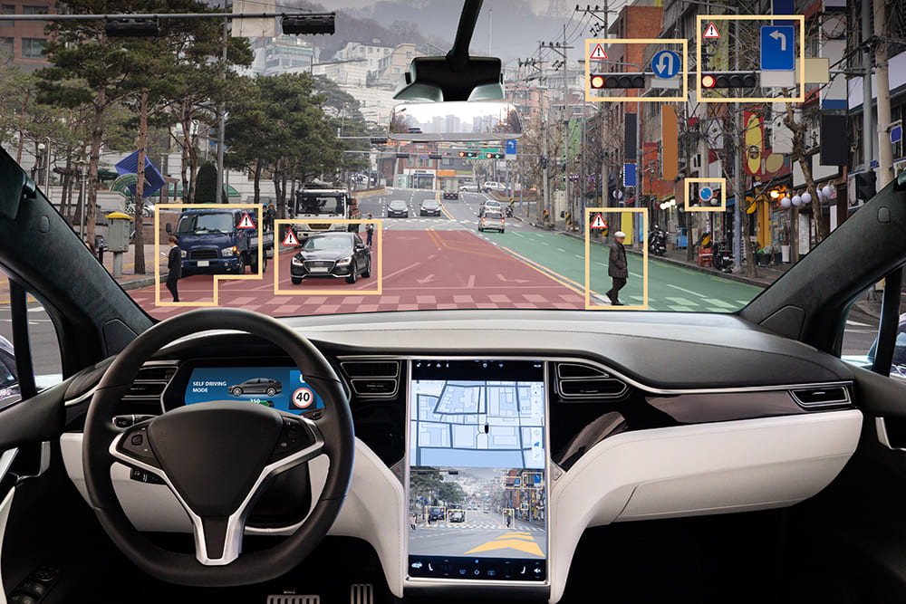
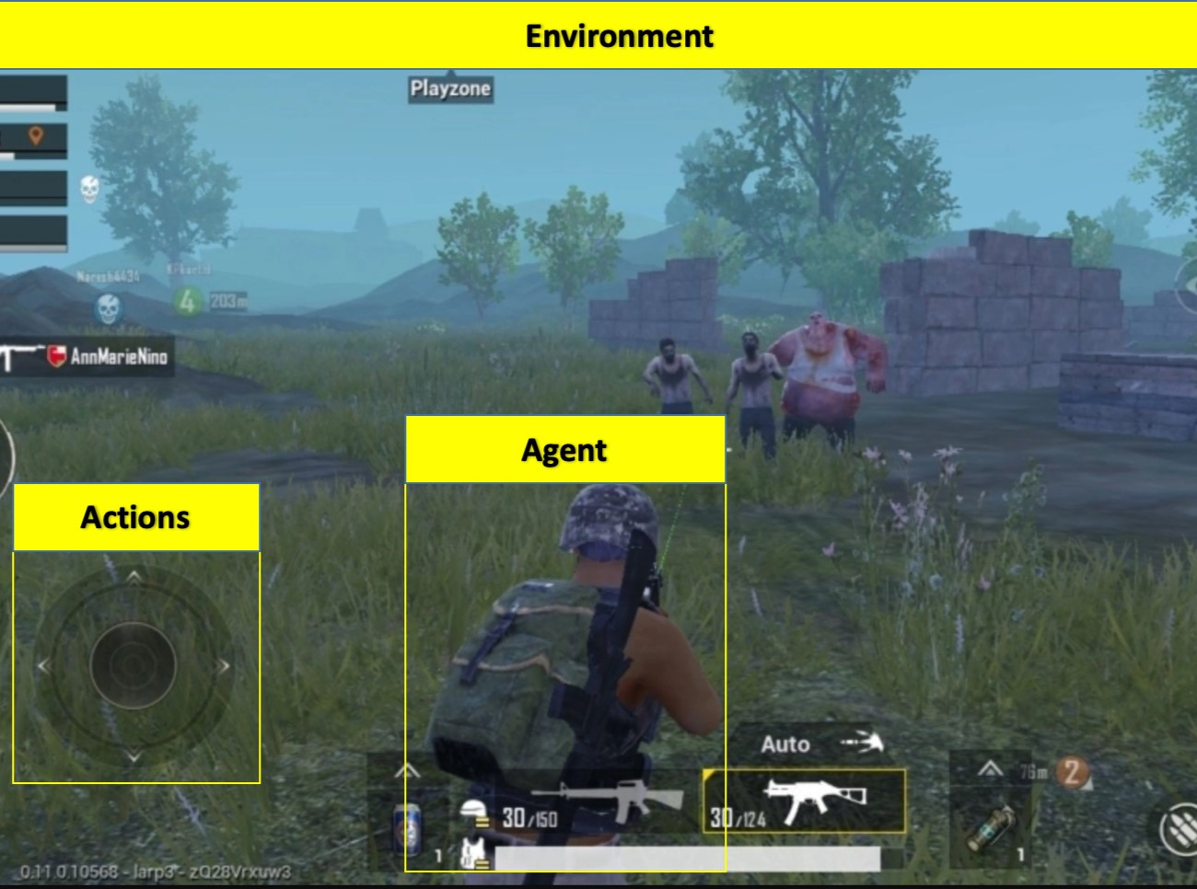

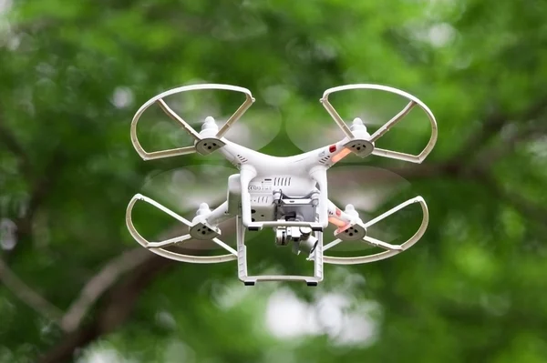
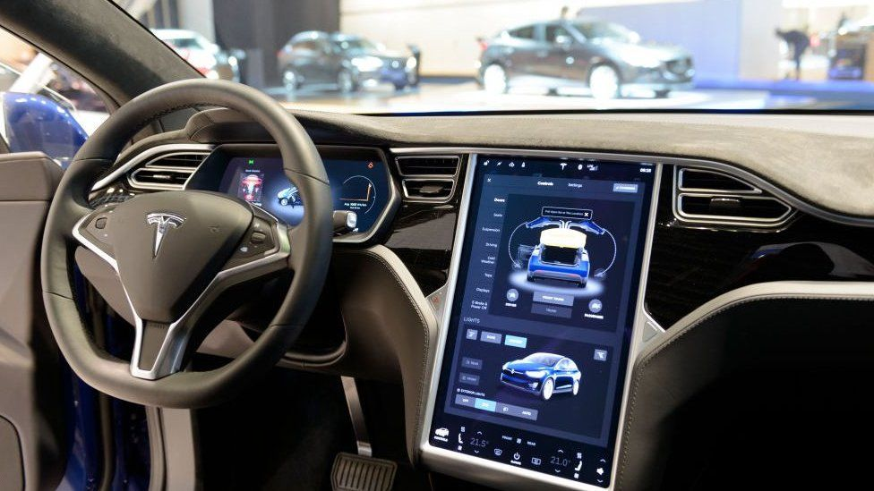
Applications of Reinforcement Learning (RL):
Robotics: RL is used to train robots to perform tasks in real-world environments.
Autonomous Vehicles: RL can be used to train autonomous vehicles to make decisions in complex traffic scenarios.
Resource Management: RL is employed in optimizing resource allocation in areas like energy management and network routing.
Game Playing: RL has been successfully applied to games like Chess, and video games.
Chatbots: RL is used to train chatbots and dialogue systems to interact more naturally and effectively with users.
Autonomous Navigation for Drones: RL is used to train drones for autonomous navigation in dynamic environments. The drone learns to make decisions on its path, avoiding obstacles and optimizing its route.

Slide 5
COMPONENTS OF REINFORCEMENT LEARNING

Slide 6
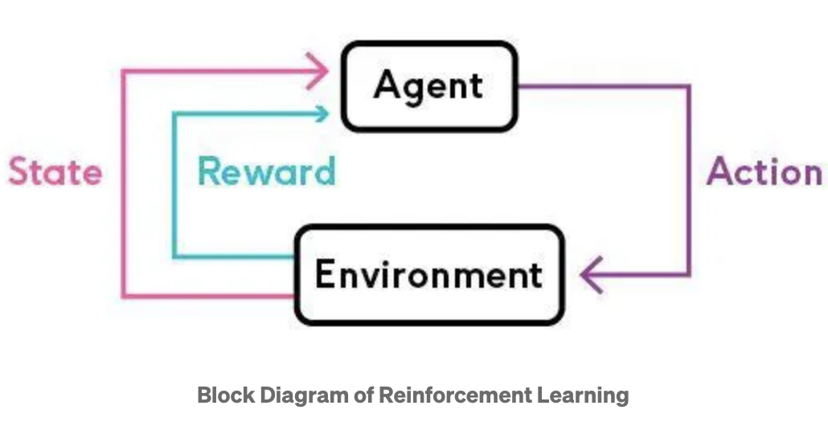
Key Components of Reinforcement Learning
Agent: The entity or system that is learning and making decisions. It takes actions in the environment to achieve a goal.
Environment: The external system or context with which the agent interacts. It provides feedback to the agent based on the actions taken.
Policy: A policy is the blueprint guiding an agent's behavior in its environment, mapping conditions to actions.
Reward: Reward function is an incentive mechanism that tells the agent what is correct and what is wrong using reward and punishment. It performs actions with the aim of maximizing rewards, to achieve the best outcomes.
.

Slide 7
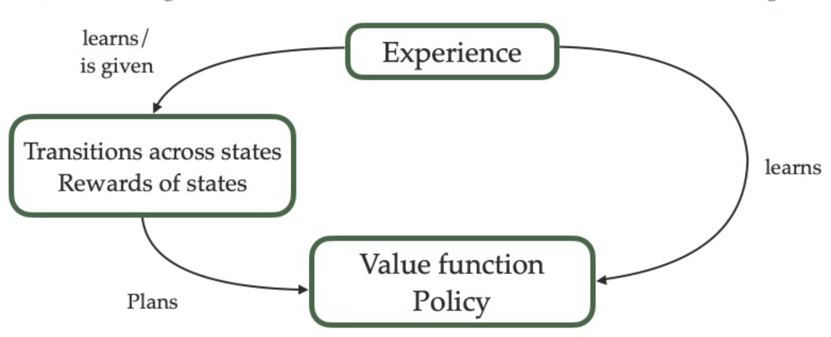
State Value: The state value represents the total reward that can be obtained from a state. It is the total amount of reward an agent can expect to accumulate over the future, starting from that state.
The function that calculates the state value is value function, represented by V or Q.
Environment Model: Some of the reinforcement systems have model of environment, that mimics the behavior of environment. It empowers the agent to forecast rewards, develop strategies based on anticipated responses, and enhances decision-making.

Slide 8
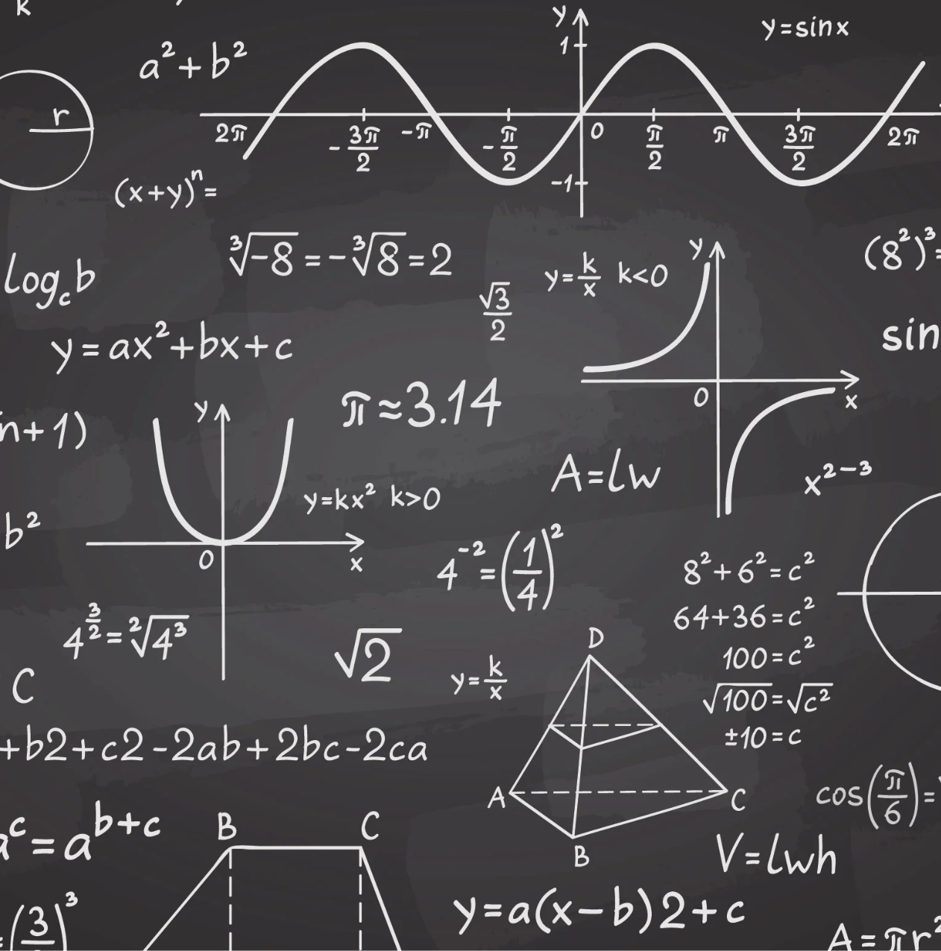
MATH BEHIND REINFORCEMENT LEARNING

Slide 9
MDP:
MDP stands for Markov Decision Process. MDPs are useful for studying optimization problems solved via dynamic programming
Typical MDP consists of {S,A,P,R}, where S stands for the set of states, A stands for the set of actions, R stands for the reward which is received when some action a is performed and changed state s to s’. P is the set of transition probabilities. It is the probability of an action being taken in state s.
Bellman’s Equation:
The Bellman equation is a fundamental equation in dynamic programming and reinforcement learning. The Bellman equation provides a way to calculate the optimal value of a state in a Markov Decision Process (MDP).
V(s) = maxa(R(s,a)+γV(s’))
value of state s
reward received for taking action a in state s
discount factor
value of the next state, s'

Slide 10
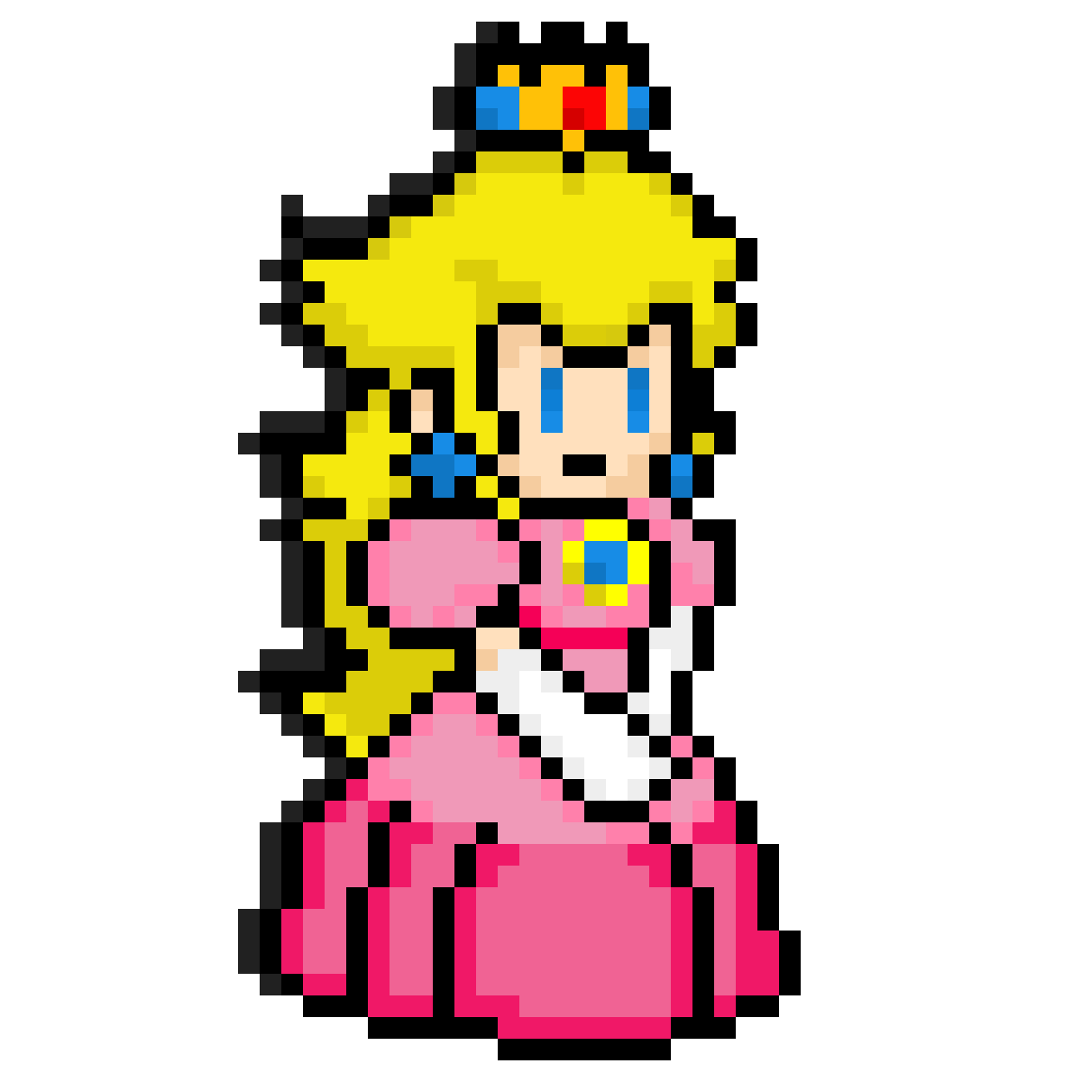
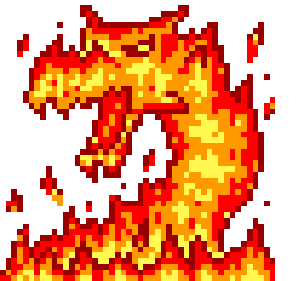
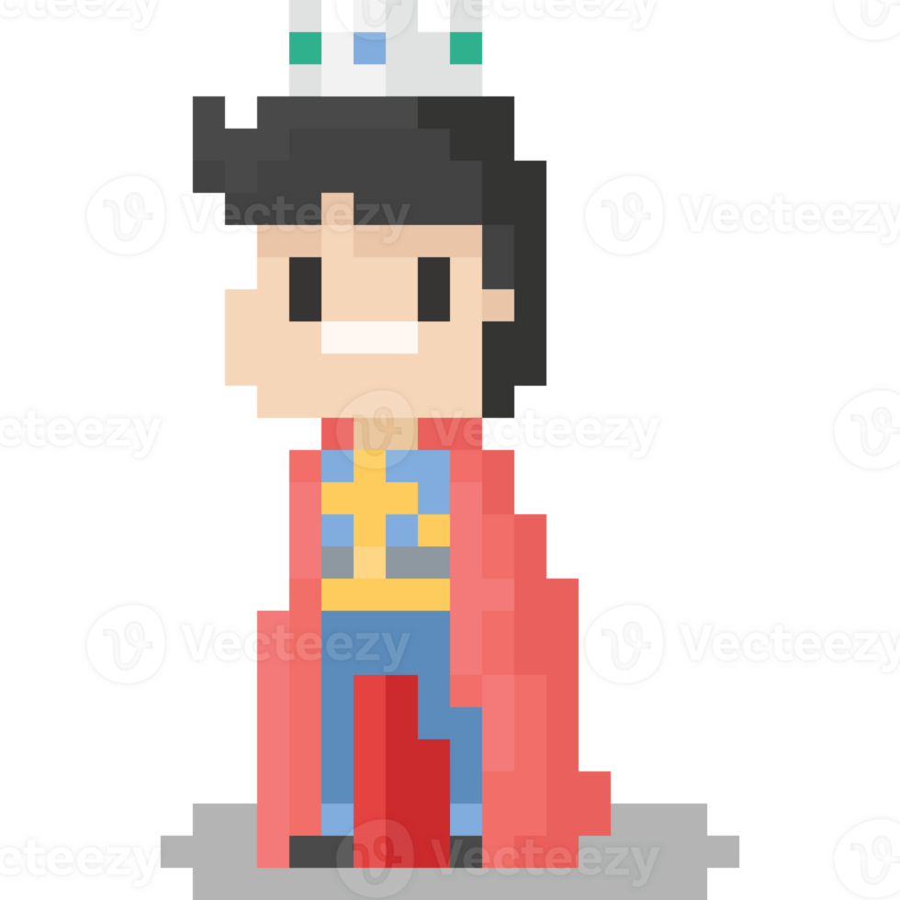
V(s) = maxa(R(s,a)+γV(s’))
γ = 1
γ = 0.9
γ = 0.9
v=1 | v=1 | v=1 | +1
v=1 |  | v=1 | -1
v=1 | v=1 | v=1 | v=1
v=0.81 (1+0.9(0.9)) | v=0.9 (1+0.9(1)) | v=1 (1+0.9(0)) | +1
v=0.73 (1+0.9(0.81)) |  |  | -1
v=0.66 (1+0.9(0.73))
v=0.81 (1+0.9(0.9)) | v=0.9 (1+0.9(1)) | v=1 (1+0.9(0)) | +1
v=0.73 (1+0.9(0.81)) |  | v=0.9 (1+0.9(1)) | -1
v=0.66 (1+0.9(0.73)) | v=0.73 (1+0.9(0.81)) | v=0.81 (1+0.9(0.9)) | v=0.73 (1+0.9(0.81))
NOTE: This learning method is called temporal difference learning, which learns by comparing the expected reward of the current state-action pair to the expected reward of the next state-action pair, without needing to wait for the end of the episode.

Slide 11
Temporal Difference Learning - Disadvantage?
TD learning is learning by Defining a policy on top of a state value function V, but it requires still some knowledge of the underlying process, since for all states s the possible successor states s′ must be known.
We need an algorithm that estimates the value function and derives an optimal policy from a set of observable quantities.
As a typical representative of model-free learning algorithms we consider Q-learning. It learns an optimal policy by iteratively building an optimal value function. The above calculations are not necessary if we estimate the Q-function.
Q-Learning
Steps involved in the Q-learning algorithm:
Q-table initialization done to track each action in each state
Observation of current state of the environment
Action is performed by agent in the environment
Update the Q-table with the results after action has been taken
Repeat steps 2-4 until the model reaches a termination state

Slide 12
Update performed is based on bellman equation:
Q(s,a) = Q(s,a) + α * (r + γ * max(Q(s',a')) - Q(s,a))
The gamma or the discount factor, is a value between 0 and 1, where a higher discount factor means that the agent values future rewards more.
The discount factor is important because it allows the agent to balance the immediate reward with the potential future rewards. It should not be too high or too low.
For example, in a game like chess, it is important to value future rewards highly, because a single mistake can lead to a loss. In a game like Pac-Man, it is also important to value future rewards, but it is also important to be able to take advantage of immediate rewards, such as food pellets.

Slide 13

A SIMPLE EXAMPLE

Slide 14
The main code parts are as follows:
Creating the reward matrix
Available actions function
Next action function
Update function
Training the Q matrix to reach goal
Code: Find attached the ipynb file, and run it to see the Q Learning Maze example!
Resource credits: https://amunategui.github.io/reinforcement-learning/index.html

Slide 15
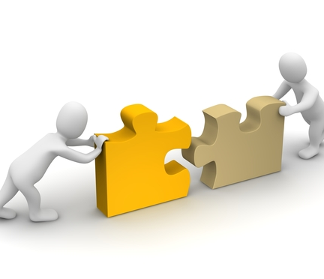
CONCLUSIONS

Slide 16
What are the disadvantages of Q-learning?
The Q-learning approach to reinforcement model machine learning also has some disadvantages, such as the following:
Exploration vs. exploitation tradeoff. It can be hard for a Q-learning model to find the right balance between trying new actions and sticking with what's already known.
Curse of dimensionality. Q-learning can potentially face a machine learning risk known as the curse of dimensionality. The curse of dimensionality is a problem with high-dimensional data where the amount of data required to represent the distribution increases exponentially.
Overestimation. A Q-learning model can sometimes be too optimistic and overestimate how good a particular action or strategy is.
Performance. A Q-learning model can take a long time to figure out the best method if there are several ways to approach a problem.

Slide 17
Key takeaways
Agent-Environment Interaction: In RL, an agent interacts with an environment. The agent takes actions, and the environment responds with rewards.
Reward Signal: The agent receives a numerical reward signal as feedback for each action it takes. The objective is to learn a policy that maximizes the total expected reward. Else it is given punishment.
Automation: Reinforcement learning automates the decision-making and learning process.
Bellman’s equation: Mathematical foundation: Q(s,a) = Q(s,a) + α * (r + γ * max(Q(s',a')) - Q(s,a))
V(s) = maxa(R(s,a)+γV(s’))
Real-life Application: Reinforcement Learning has changed the dynamics of various sectors like Healthcare, Robotics, Gaming, Retail, Marketing, and many more.
“Most human and animal learning can be said to fall into unsupervised learning. It has been wisely said that if intelligence was a cake, unsupervised learning could be the cake, supervised learning would be the icing on the cake, and reinforcement learning would be the cherry on the top.”

Slide 18
THANKYOU

